Slide 1
DATA MANAGEMENT FINAL PROJECT
LOS ANGELES CRIME DATA FROM 2020 TO PRESENT
Group 15
By:
Balajigowda,Rachelle Azulay, Mihir Patangia, KylieLoudermilk, Xilin Yang

Slide 2
Table of Contents
01
02
03
04
05
06
Dataset Intro
Question 1
Question 2
Question 3
Some Facts
Conclusion

Slide 3
Crime Data In Los Angeles
Dataset sourced by the Los Angeles Police Department
28 fields
843,514 rows
Each row represents an incident of crime
Timeframe: Jan.01. 2020-Nov. 12. 2023
https://data.lacity.org/Public-Safety/Crime-Data-from-2020-to-Present/2nrs-mtv8/about_data

Slide 4
Importance Of Our Dataset
Relevance
Depth of Analysis Potential
Focus: Crime incidents in Los Angeles from 2020 to present.
Usefulness: Identifying trends, studying patterns and informing the public
Rich Data: Allows for complex statistical analyses.
Insightful: Facilitates in-depth understanding of crime causation and correlations.
Diversity in Data Variables
Geographic Specificity
Area: Specific to Los Angeles.
Advantage: Vital for local policymakers, law enforcement, and researchers.
Focus: Offers deep insights into local crime dynamics.
Variables: 28 columns including date/time, location, crime types.
Benefit: Enables nuanced exploration of crime-related factors.

Slide 5
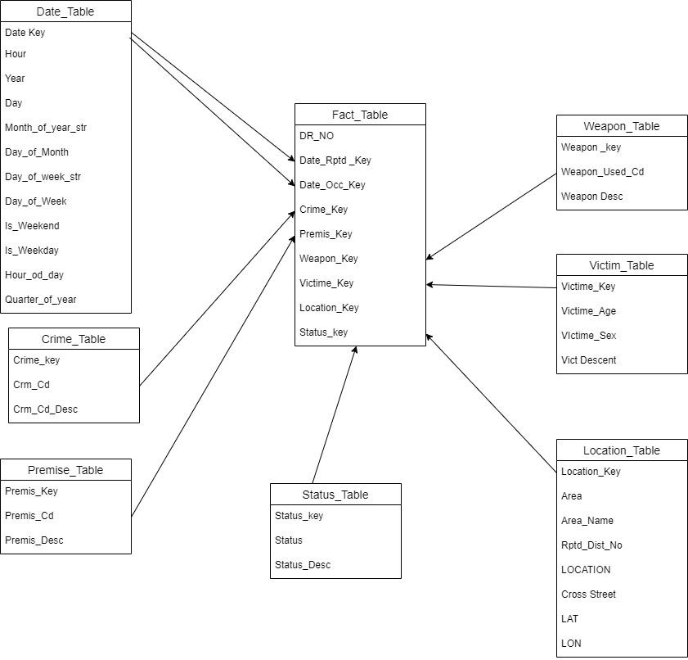
Schema
Notes:
7 different dimensions

Slide 6
QUESTION 1:
How has the overall crime rate in the city behaved over the past few years?

Slide 7
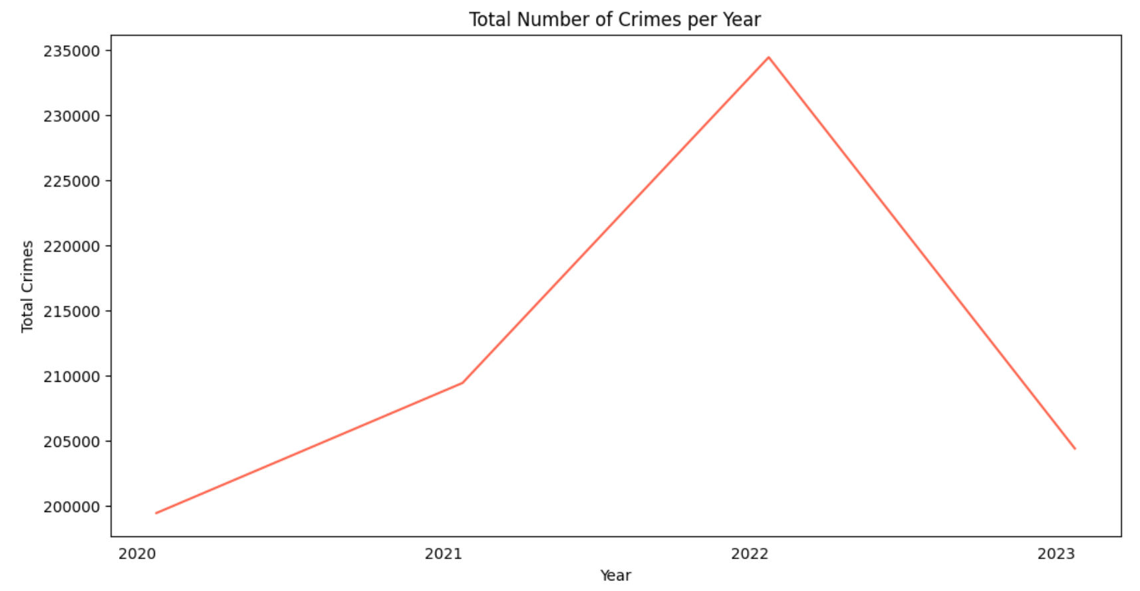
Crime Occurrences per Year
2020 shows lowest number of crimes occurred
2022 shows highest number of crimes occurred
Avg. number of reported crimes occurred per year: 211,000
Avg. number of reported crimes occurred per day: 590
+10.6%
- 14.6%
+4.8%
Notes:
This plot represents a high level view of the number of occurrences of crime in Los Angeles per year between 2020 and November 2023. We can tell from this view that there was a steady increase in crime from 2020 through 2021,

Slide 8
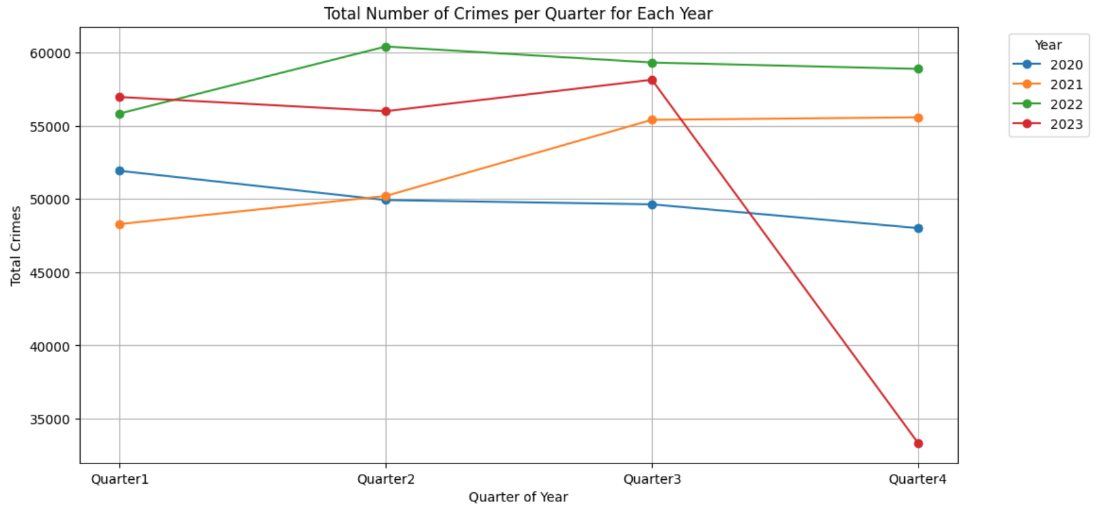
Crime Occurrences per Quarter by Year
2022 marks the highest crime rates across 3 out of 4 quarters.
Consistent rise in crime occurrences in 2021 leads into the peak present in 2022.
Quarter with highest average: Q3 - 56,000
Quarter with lowest average: Q1 - 53,000
Note: This dataset includes no data from December 2023

Slide 9
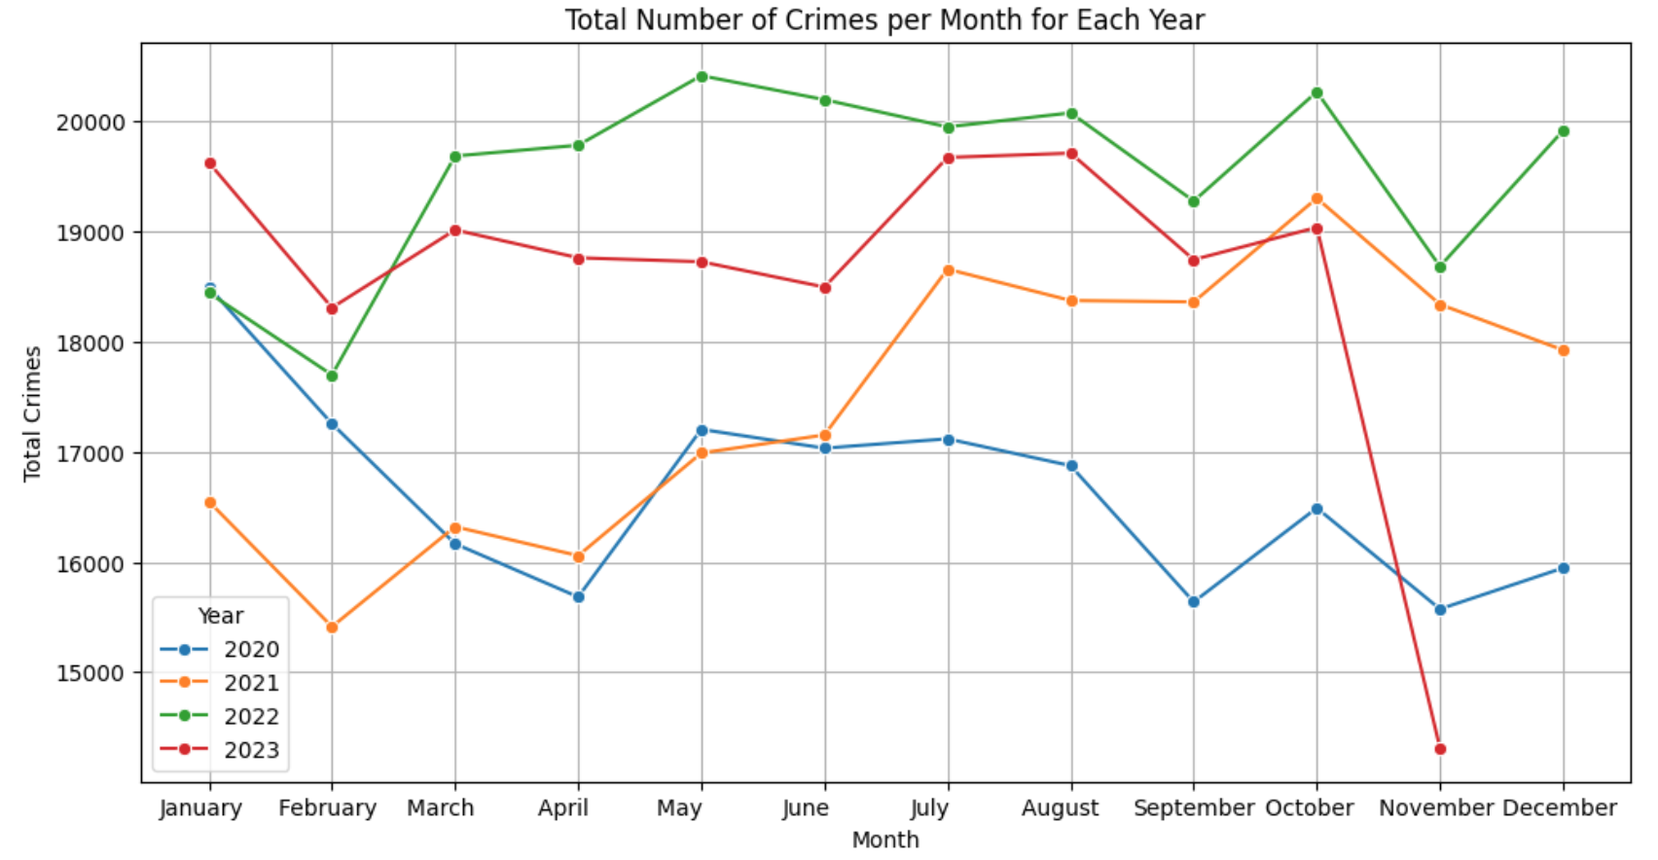
Crime Occurrences per Month by Year
4/5 of the peak months for occurrences of crime are summer months
2020 crime patterns hint at well known environmental factors such as the onset of the COVID-19 pandemic and increased social unrest in the summer of 2020
Note: This dataset includes no data from December 2023

Slide 10
What are the top 10 types of crimes that have been solved and unsolved?
Question 2

Slide 11
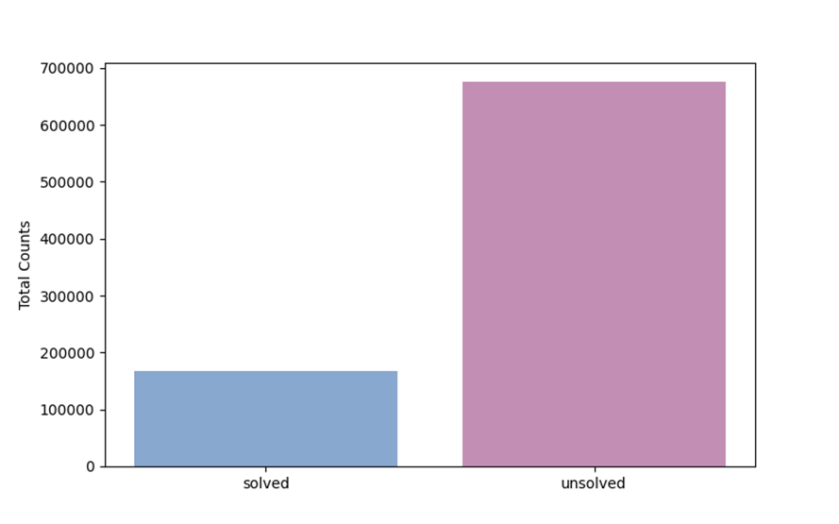
Overview of Solved and Unsolved Cases
Solved is 168389
Unsolved is 675125
Approximately 80%

Slide 12
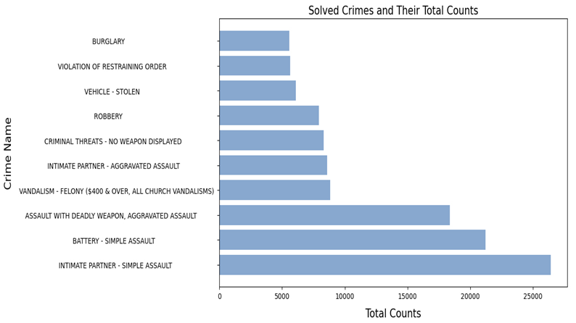
Most Resolved Crime Categories
INTIMATE PARTNER - SIMPLE ASSAULT: 26,413
BATTERY - SIMPLE ASSAULT: 21,204
ASSAULT WITH DEADLY WEAPON: 18,374
VANDALISM - FELONY: 8,824
INTIMATE PARTNER - AGGRAVATED ASSAULT: 8,595

Slide 13
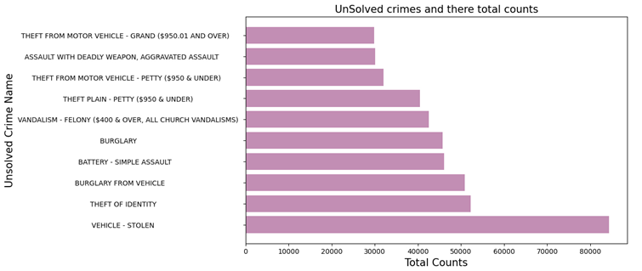
Most Unsolved Crime Categories
Vehicle Stolen: 84,351 cases
Tops the list with the highest number of unsolved cases
Theft of Identity: 52,214 cases
Burglary from Vehicle: 50,856 cases
Battery - Simple Assault: 46,096 cases

Slide 14
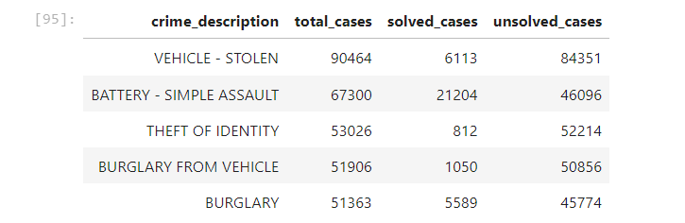
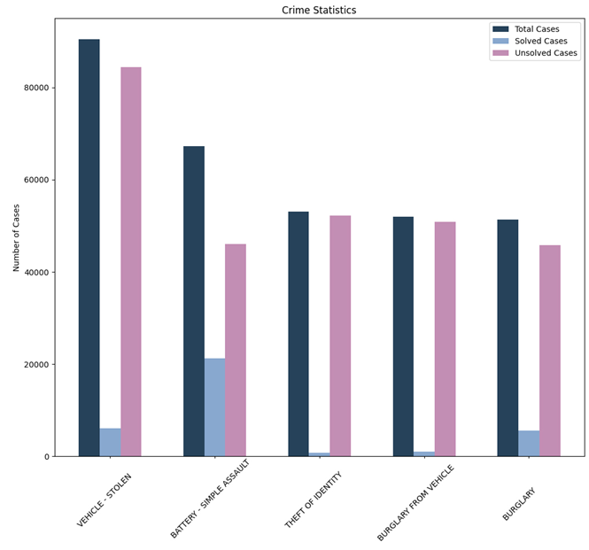
Comparative Analysis of Crime Cases for Top 5 Crimes

Slide 15
QUESTION 3:
What is the distribution of total crime victims across different age groups? and
What are the top 3 crimes and their counts for each age group of the victims?

Slide 16
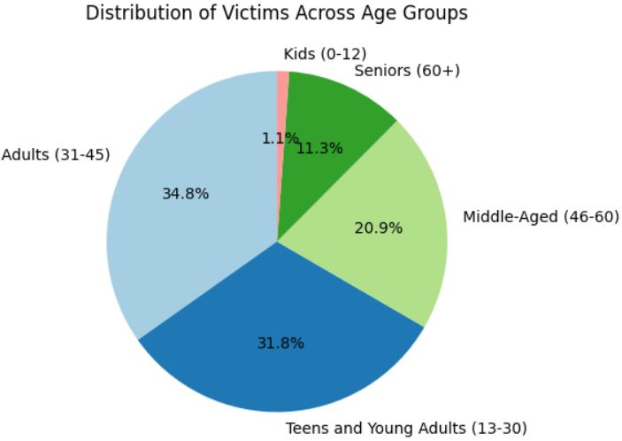
Age Group Categorization of Victimis
AGE CATEGORY | AGE GROUP | TOTAL VICTIMS
ADULTS | 31-45 | 220759
TEENS AND YOUNG ADULTS | 13-30 | 201944
MIDDLE-AGED | 46-60 | 132648
SENIORS | 60+ | 71770
KIDS | 0-12 | 7284

Slide 17
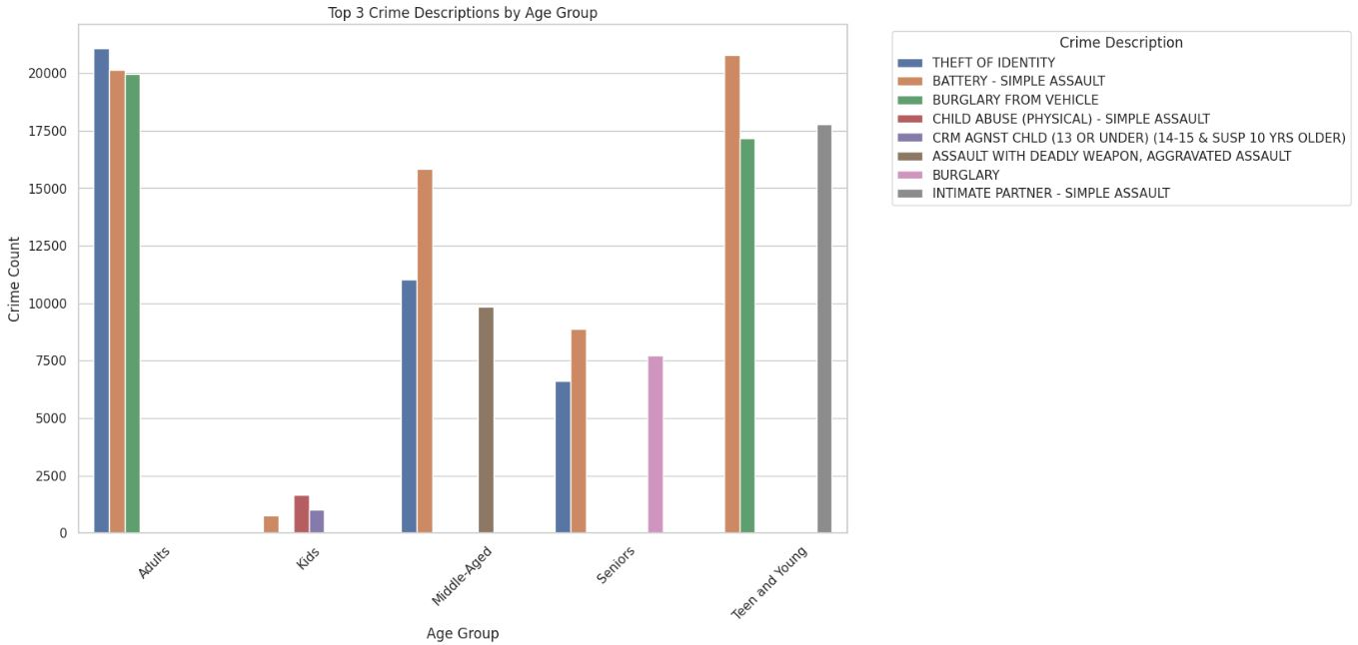
‘THEFT OF IDENTITY’, ‘BATTERY - SIMPLE ASSAULT’, ‘BURGLARY FROM VEHICLE’ are the most prevalent crimes across various age groups.
‘ASSAULT WITH DEADLY WEAPON’, majority of the victims are in the age-category of Middle-Aged.
"INTIMATE PARTNER - SIMPLE ASSAULT" is a notable crime for the 'Teen and Young' age group.

Slide 18
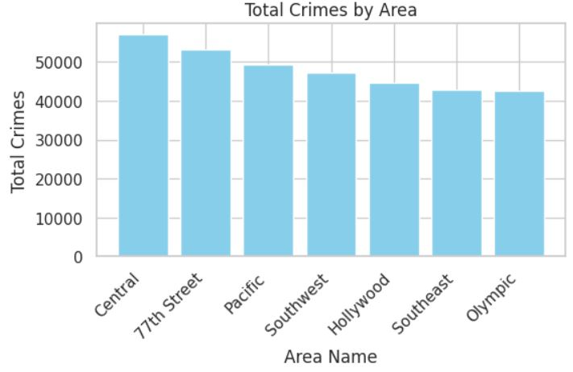
Neighborhoods that have the highest crime rates
"Central" area reported the highest crimes at 57,280 incidents.
"77th Street" followed with 53,324 incidents, and "Pacific" reported 49,502 incidents. Other notable areas include "Southwest" (47,581), "Hollywood" (44,790), "Southeast" (43,127), and "Olympic" (42,732).

Slide 19
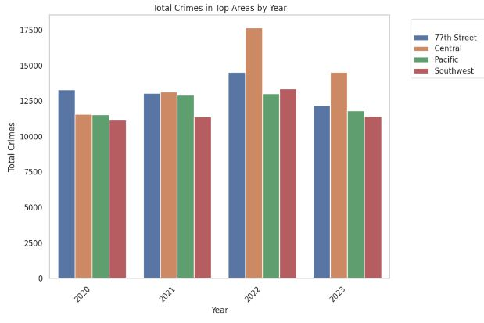
Top Areas for crime in all the 4 Years are
77th Street
Central
Pacific
Southwest

Slide 20
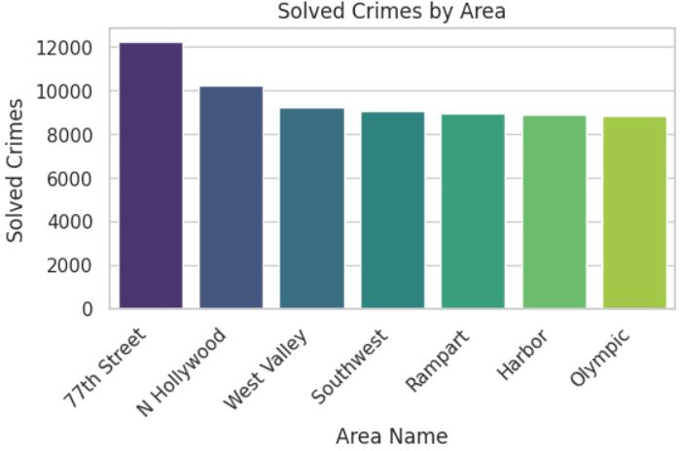
Top Areas where Most number of crimes are solved
77th Street
N Hollywood
West Valley
Southwest
Rampart
Harbor
Olympic

Slide 21
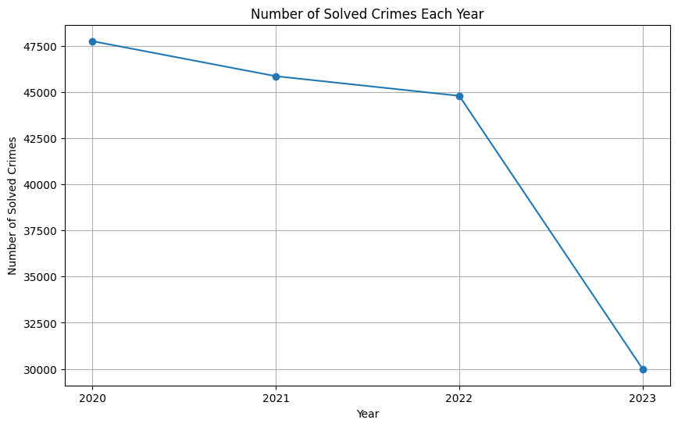
How many crimes were solved each year?
2020: 47,751 solved crimes
2021: 45,854 solved crimes
2022: 44,790 solved crimes
2023: 29,994 solved crimes

Slide 22
Conclusion
Focused Policing:
Concentrate law enforcement efforts in high-crime areas like "Central," "77th Street," and "Pacific."
Targeted Interventions:
Address specific crimes, e.g., "Vehicle - Stolen," with tailored strategies.
Seasonal Planning:
Adapt policing strategies based on seasonal and quarterly crime trends.
Enhanced Law Enforcement Resources:
Consider recruiting additional personnel to address the backlog of pending cases and improve overall resolution rates.

